Slide 1

Click-Through Rate (CTR) Prediction
By: Vidushi Raval
Date: June 28, 2025

Slide 2


Introduction
Importance of CTR in online advertising
Key Reasons CTR Matters:
1. Ad Effectiveness & ROI
2. Cost Optimization
3. Improved Targeting
4. User Experience Enhancement
5. Budget Allocation
Goal of the project:
The main goal of this project is to predict whether a user will click on an online advertisement using machine learning. We used historical ad impression data to build a model that can estimate the click probability for new ads.

Slide 3
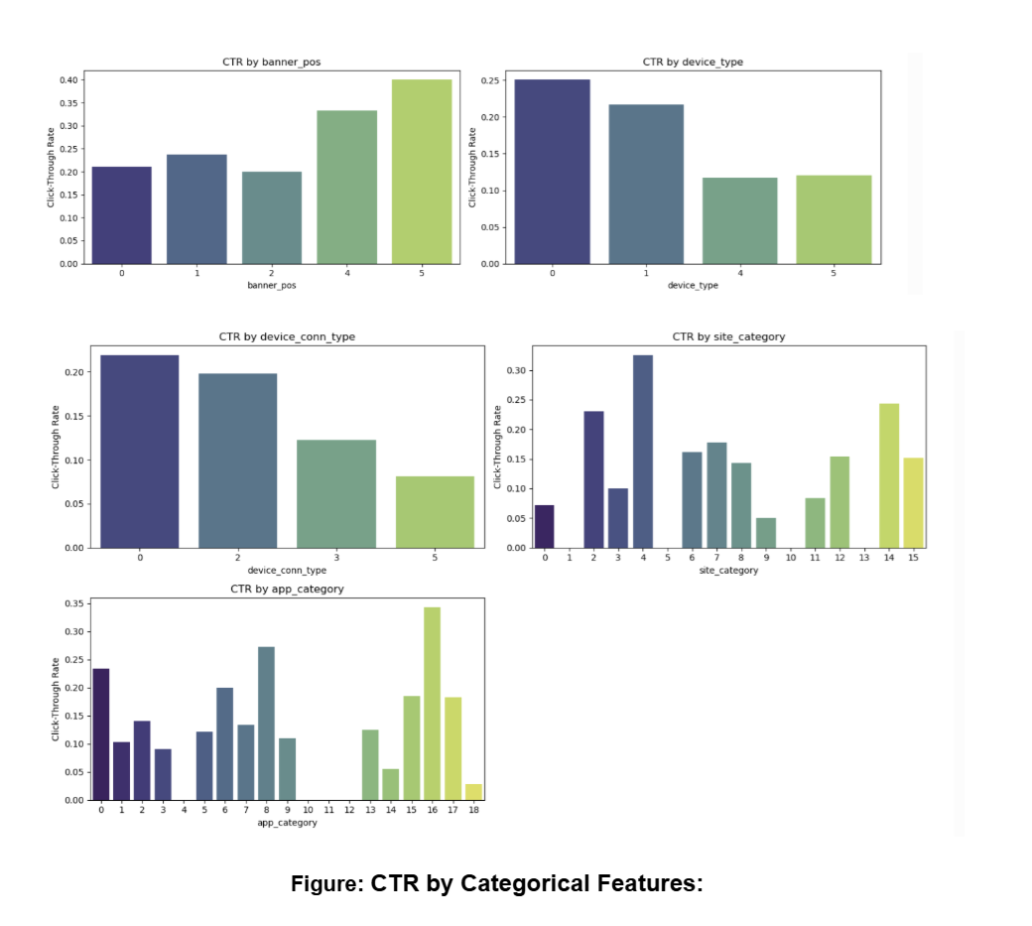
Project Objectives
🔍 Identify key drivers of Click-Through Rate (CTR)
🧠 Build and evaluate predictive models
📊 Address class imbalance for better prediction

Slide 4
Data Source
Kaggle Avazu CTR Dataset Overview:
https://www.kaggle.com/competitions/avazu-ctr-prediction/overview
Features And
Size
Summary Table:
| Metric | Value |---------- |--------- | Rows | 75,058 | Columns | 25 | Categorical Vars | 23 | Numerical Vars | 2 | Target Var | click (0/1)

Slide 5
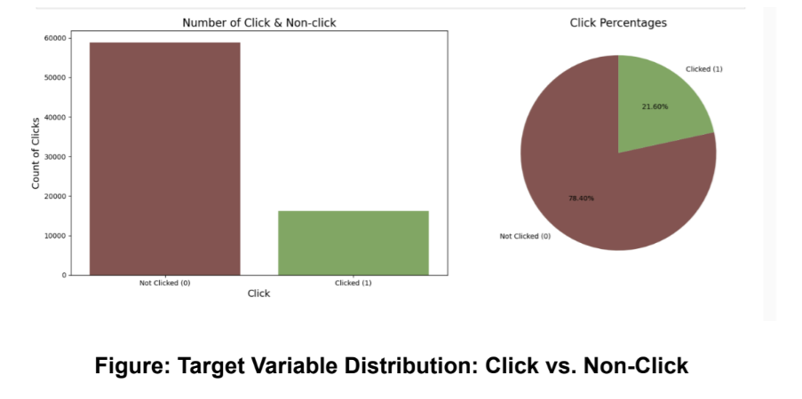
Problem Statement
Challenges:
High cardinality
Class imbalance
Non-linear user behavior

Slide 6
Data Cleaning & Preprocessing
Handling missing values
Categorical encoding
Data splitting
Step | Description
Missing Values | Verified no missing values in any columns
Data Type Conversion | Converted 23 object columns to category → reduced memory to ~3.9MB
Label Encoding | Applied to high-cardinality categorical features
Feature Engineering | Created binary features like is_high_ctr_site
Data Splitting | 80/20 split; preserved class imbalance
Notes:
This slide summarizes the preprocessing steps I performed to prepare the data for modeling:
Missing Values: I verified that there were no missing values in any column, so no imputation or row removal was needed.
Data Type Conversion: I converted 23 object-type columns to the category data type. This reduced memory usage from about 150MB to approximately 3.9MB, improving overall processing efficiency.
Label Encoding: High-cardinality categorical features such as site_id, device_id, and app_id were encoded using label encoding. This preserved the uniqueness of values without inflating the feature space.
Feature Engineering: I created custom binary features such as is_high_ctr_site and is_high_ctr_app based on early EDA findings to highlight high-performing categories.
Data Splitting: The dataset was split into 80% training and 20% test sets. Importantly, I preserved the original class imbalance so the model could learn from realistic class distributions.
These steps ensured the data was clean, compact, and ready for training robust models.

Slide 7
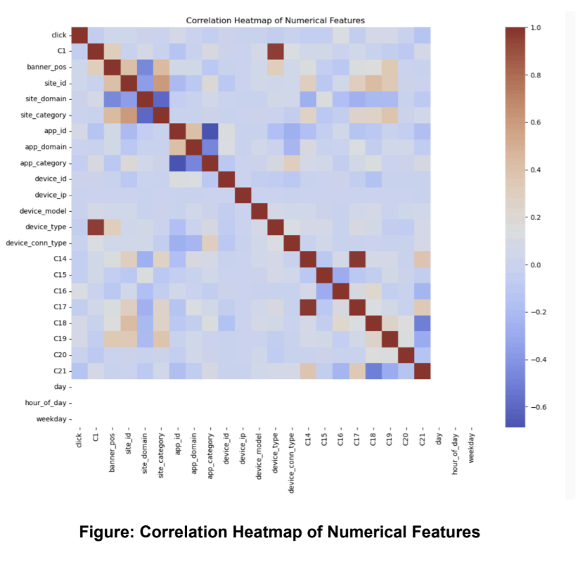
Exploratory Data Analysis (EDA)
Purpose of EDA
Examined target variable distribution (click vs. non-click)
Discovered significant class imbalance (clicks ≈ 21.6%)
Identified skewed categorical features (site_id, app_id, device_type, etc.)
Explored CTR patterns across devices, sites, and time
Used correlation heatmaps and violin/bar plots to spot trends

Slide 8
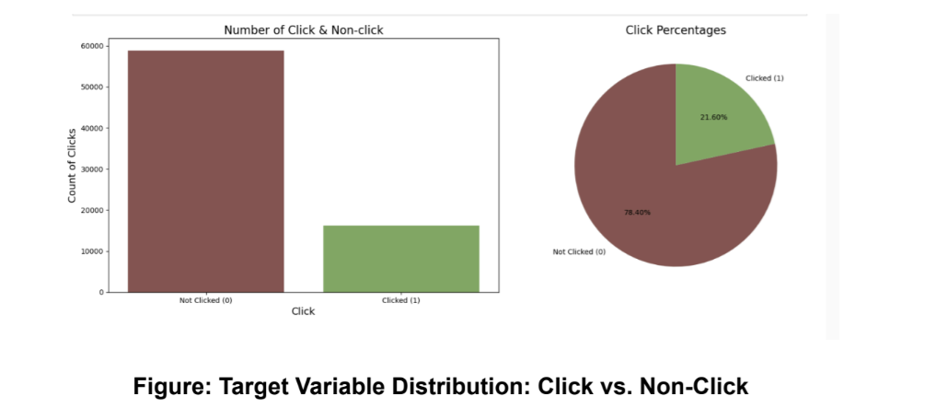
EDA: Target Variable Distribution
Only ~21.6% of impressions resulted in a click.
This imbalance can bias models toward predicting the majority class (non-clicks),
reducing recall and overall effectiveness.

Slide 9
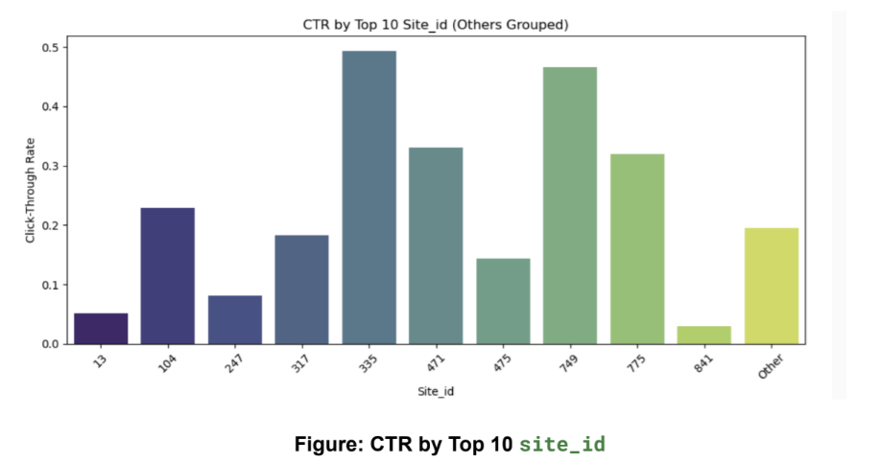
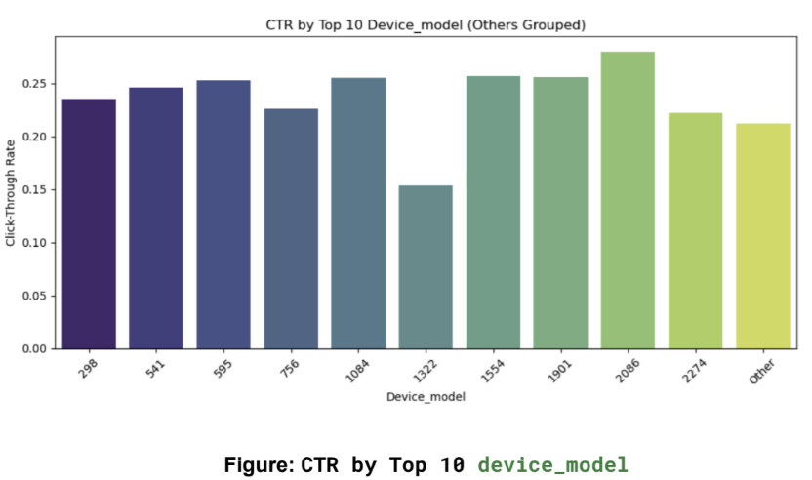
Feature Distributions:
Top Categories:
Certain categories like site_id 250 and app_id 634 show exceptionally high CTRs, acting as outliers or key drivers of engagement.
These outliers may represent popular platforms or high-conversion campaigns.
We grouped rare values under ‘Other’ to handle high cardinality and reduce model complexity.
These insights helped us decide which categories to prioritize or consolidate during feature engineering.

Slide 10
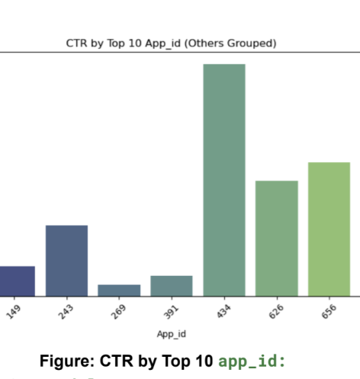
CTR Distribution by Top App IDs - Outliers
app_id 434 shows exceptionally high CTR (~0.4) – a clear outlier.
Likely represents a high-conversion app or highly engaging context.
Rare app_ids grouped under ‘Other’ to reduce model complexity.
Insight helped guide feature encoding and model focus.

Slide 11
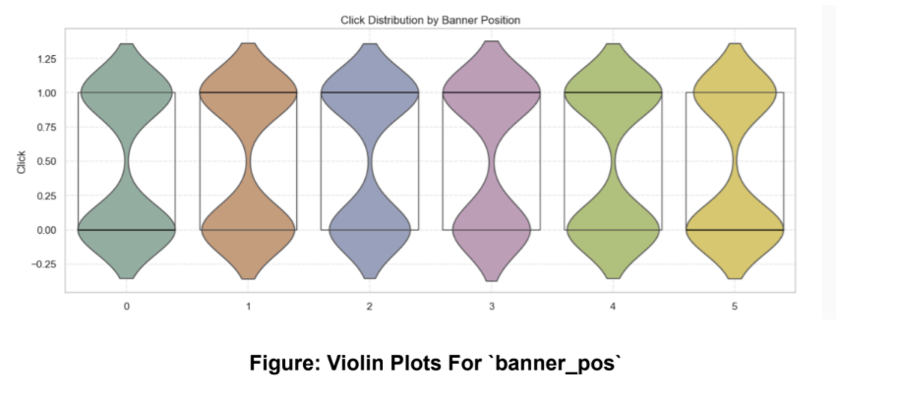
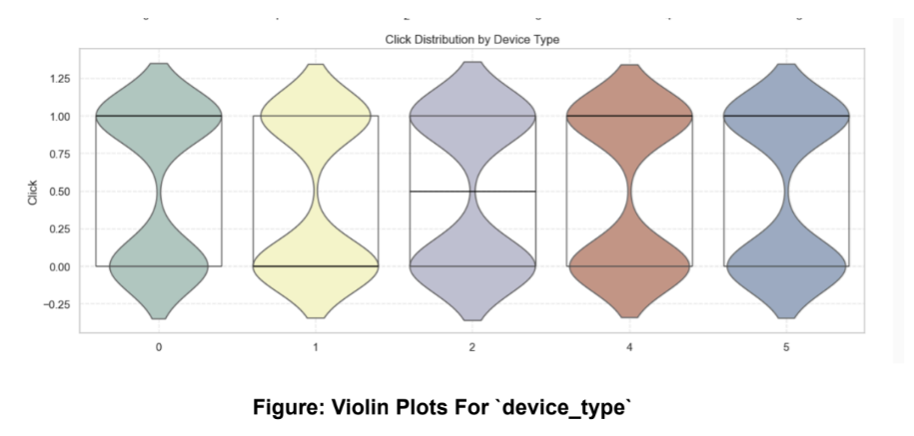
Feature Distributions: Skewness
Click Distribution by Banner Position
Click Distribution by Device Type
Certain feature values dominate (e.g., banner_pos = 0, device_type = 1), indicating skewness in categorical distribution.

Slide 12
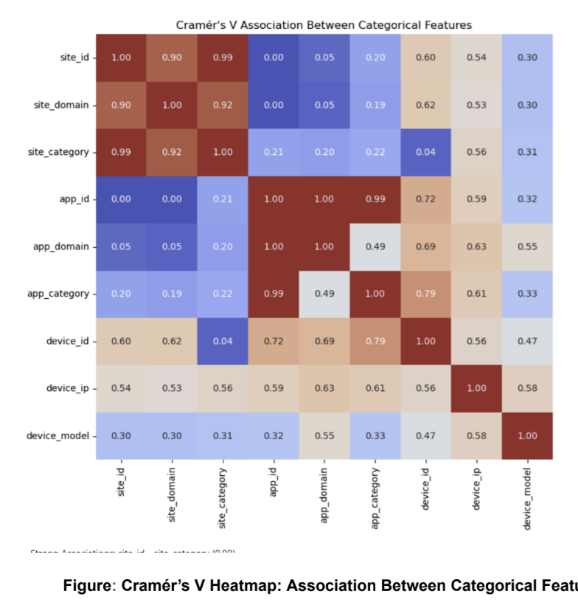
EDA: Correlation Analysis – Categorical Feature Associations
Multicollinearity Insights (Categorical Features):
Strong associations observed:
site_id ↔ site_category: 0.99
app_id ↔ app_category: 0.99
site_id ↔ site_domain: 0.90
These pairs show redundancy, where one variable can represent the other.
Such redundancy doesn’t impact tree-based models (e.g., XGBoost), which can naturally handle multicollinearity.
These insights guided feature pruning and improved model interpretability

Slide 13
Modeling Approach
Models Compared:
Logistic Regression A baseline linear model; interpretable but limited in capturing non-linear relationships and multicollinearity.
Random Forest A tree-based ensemble model; handles high-dimensional and categorical data well; robust to overfitting and multicollinearity.
XGBoost Gradient boosting model; offers strong performance, handles class imbalance, and models complex feature interactions.

Slide 14
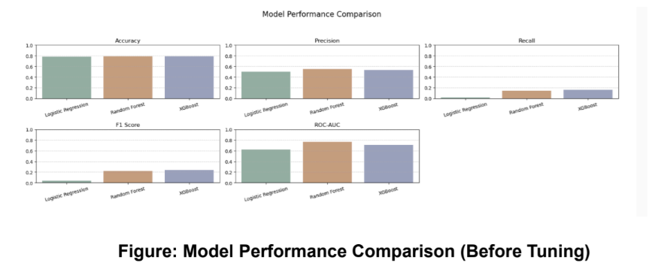
Baseline Model Performance
Logistic Regression underperforms across all key metrics.
Random Forest and XGBoost perform better on recall and ROC-AUC, which are critical for imbalanced classification.
XGBoost slightly edges out in F1 score, making it a promising model to tune further.

Slide 15
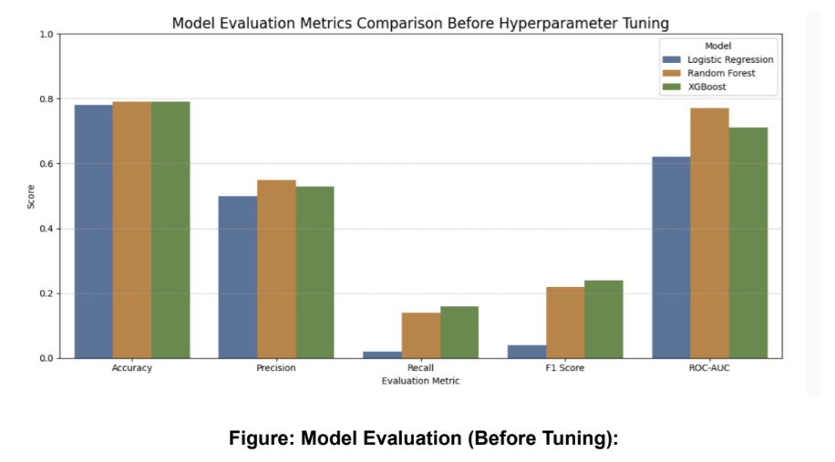
Model Evaluation – Before Tuning
Accuracy is similar across all models (~0.78–0.79), making it less informative due to class imbalance.
Random Forest achieves the highest ROC-AUC (~0.81), showing strong separation ability between clicked vs. non-clicked.
XGBoost scores the highest on F1 Score, making it a better balanced choice between precision and recall.
Logistic Regression lags behind in recall and F1 Score, confirming it’s less effective for imbalanced classification.

Slide 16
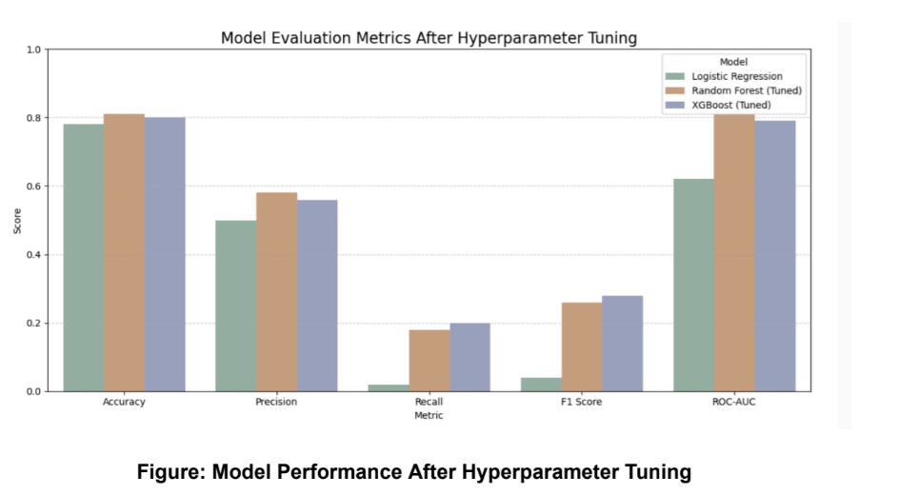
Model Performance – After Tuning

Slide 17
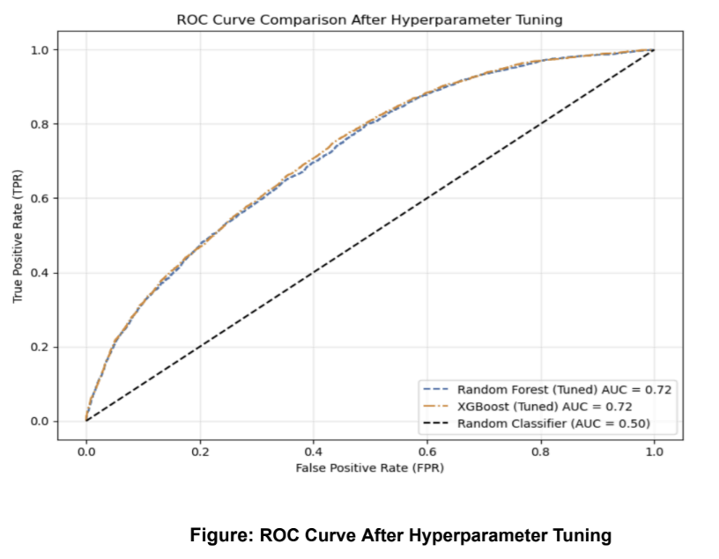
Model Performance – After Tuning
XGBoost and Random Forest show significant gains in recall and F1 score after tuning.
Both models reach ROC-AUC ≈ 0.72, indicating improved class separation.
Accuracy remains high (~0.78–0.82) across all models.
Hyperparameter tuning enhances model robustness for imbalanced CTR prediction.
XGBoost (Tuned) emerges as the most balanced and best-performing model.
Tuned models (XGBoost & Random Forest) both reach ROC-AUC = 0.72, a clear improvement from baseline.
ROC curve shows strong separation from the random classifier (AUC = 0.50), confirming predictive power.
F1 score improvements reflect better balance between precision and recall.
Hyperparameter optimization was critical in maximizing performance for CTR classification.

Slide 18
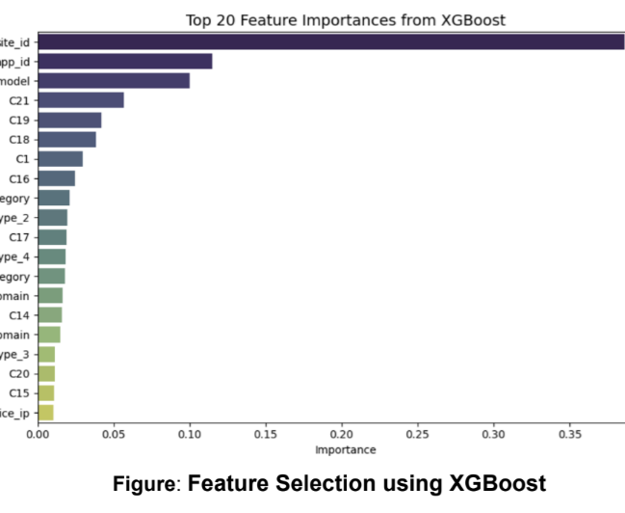
Feature Selection using XGBoost
XGBoost feature importance helped identify the most predictive variables.
site_id, app_id, and device_model emerged as the top contributors to CTR prediction.
Features like C21, C19, and device_conn_type_2 also showed moderate influence.
Low-importance features such as device_ip and C15 were candidates for removal to reduce noise and dimensionality.
Final model was retrained after dropping features below a threshold importance (e.g., < 0.005), improving performance and generalizability.

Slide 19
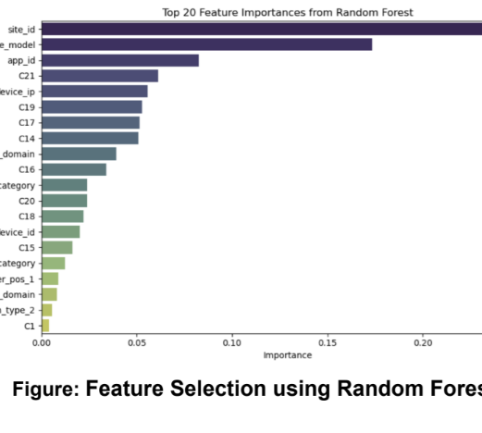
Feature Selection using Random Forest
Additional strong contributors include device_ip, C21, and C19.
Low-importance features like device_conn_type_2, C1, and app_domain were reviewed for possible removal to reduce model complexity.
This ranking helped validate and cross-check important variables selected by other models (e.g., XGBoost).

Slide 20
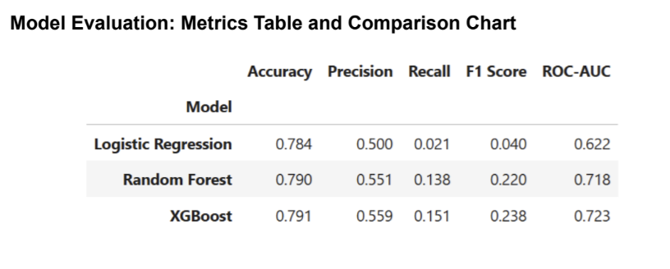
Model Evaluation – Before Hyperparameter Tuning
• XGBoost outperforms other models across all metrics even before tuning.
• Logistic Regression has the lowest recall (0.021) and F1 score (0.040).
• XGBoost shows the best balance of precision, recall, and ROC-AUC.
• Indicates that tree-based models are better suited for CTR prediction.

Slide 21
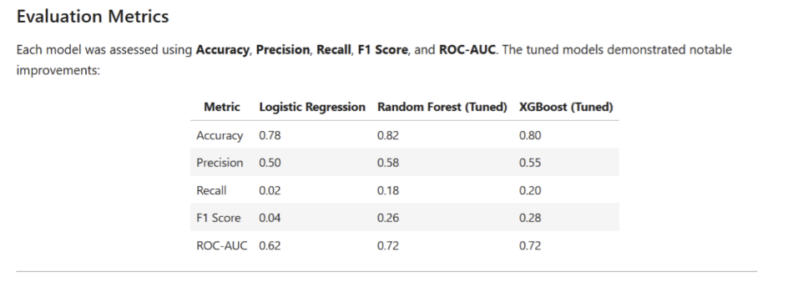
Evaluation Metrics – After Hyperparameter Tuning
• All models showed performance gains after hyperparameter tuning.
• Random Forest achieved the highest accuracy (0.82).
• XGBoost showed the best balance of recall (0.20) and F1 Score (0.28).
• Both tree-based models reached a ROC-AUC of 0.72, indicating improved classification.
• Logistic Regression improved slightly but remained weaker in recall and F1 Score.

Slide 22
Recommendations
Ad scheduling
Analyze CTR by hour/day to identify peak engagement times.
Schedule ads during high-CTR windows (e.g., late evenings or weekends) for better visibility and cost efficiency.
Reduce ad impressions during low-CTR periods to optimize budget.
Device targeting
Model results show variation in CTR across devices.
Prioritize devices with higher predicted CTR (e.g., smartphones).
Tailor ad formats based on device usage patterns (e.g., mobile-optimized visuals for phones).
Real-time scoring
Deploy the model as a live API for scoring ad impressions in real time.
Serve ads only to users with high click probability.
Enables dynamic decision-making and adaptive bidding strategies.

Slide 23

Future Work
Richer Features
Cold Start Handling: Combine collaborative filtering (based on similar users/items) with content-based methods using metadata like ad category and device info.
Additional User Data: Include session history, geographic location, and behavioral patterns to boost personalization and predictive performance.
Deep Learning Models
Explore RNNs or CNNs to capture sequential behavior and time-based dependencies in user interactions.
Class Imbalance Strategies
Try SMOTE, ensemble bagging, or other resampling methods to improve recall for minority class predictions.
Hypothesis Testing
Use statistical techniques such as chi-square tests and z-tests to validate observed CTR patterns and enhance feature engineering.

Slide 24

Acknowledgements
This project was completed as part of the Springboard Data Science Foundations to Core Career Track Capstone Two.
I would like to express my sincere gratitude to my mentor, Manish Pathak, for his invaluable guidance and feedback throughout the project.
I also acknowledge the Springboard team for providing support and structure, and the Kaggle community for sharing accessible datasets and insights.

Slide 25

Q&A / Thank You
GitHub Repo: CapstoneTwo_CTRprediction
https://github.com/VidushiR/Springboard/tree/main/CapstoneTwo_CTRprediction

